Slide 1
Numerical example of evaluation metrics
TDT17 - M4-T4-P10-N

Slide 2
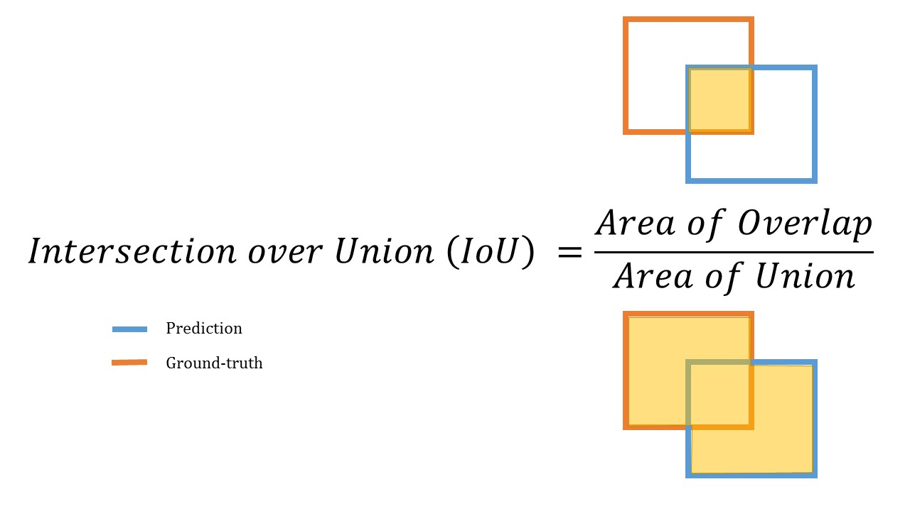
IoU - Intersection over Union
Evaluation metric used to to measure the accuracy of an object detector
IoU > 0.5 is normally considered a “good” prediction

Slide 3
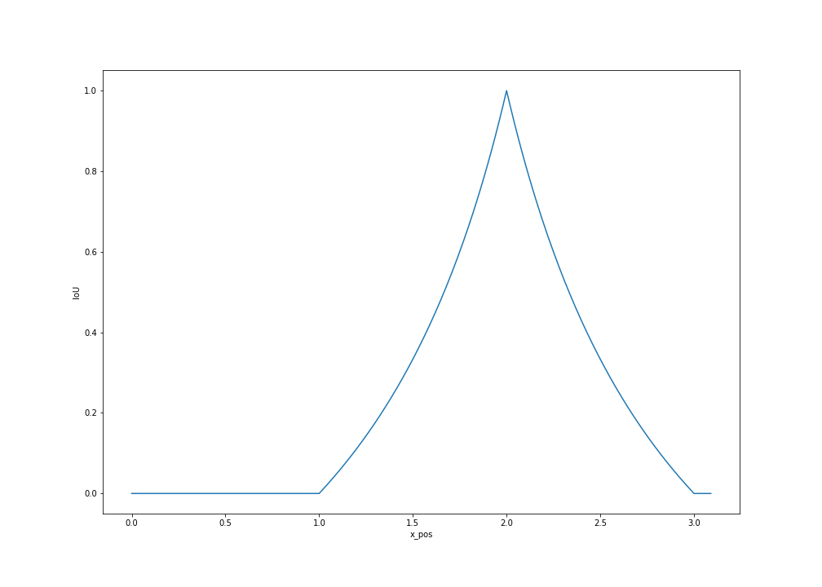
IoU - Intersection over Union
x_pos: x coordinate of the lower left corner of the bounding box.

Slide 4
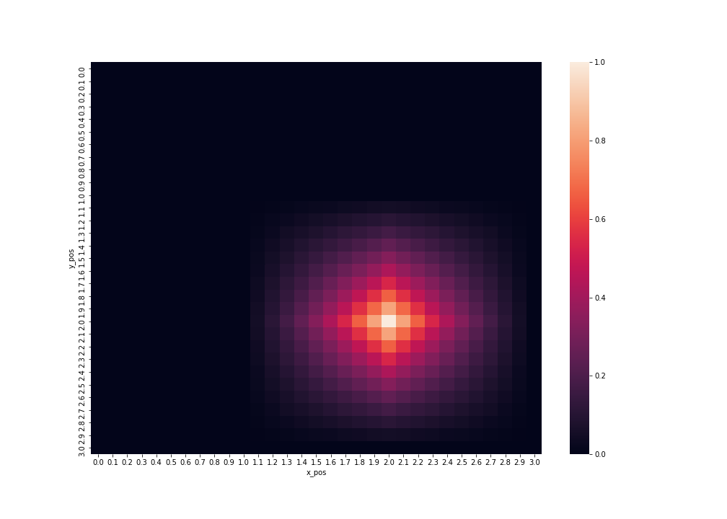
IoU - Intersection over Union
x_pos: x coordinate of the lower left corner of the bounding box.
y_pos: y coordinate of the upper right corner of the bounding box.

Slide 5
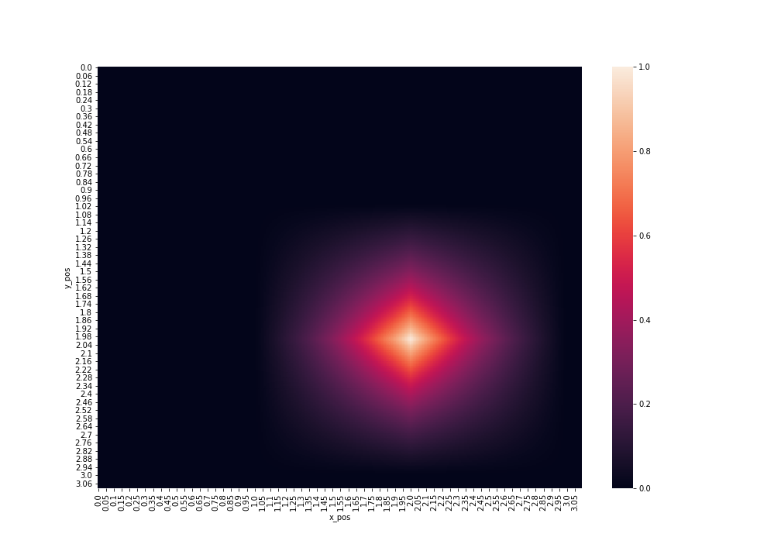
IoU - Intersection over Union

Slide 6
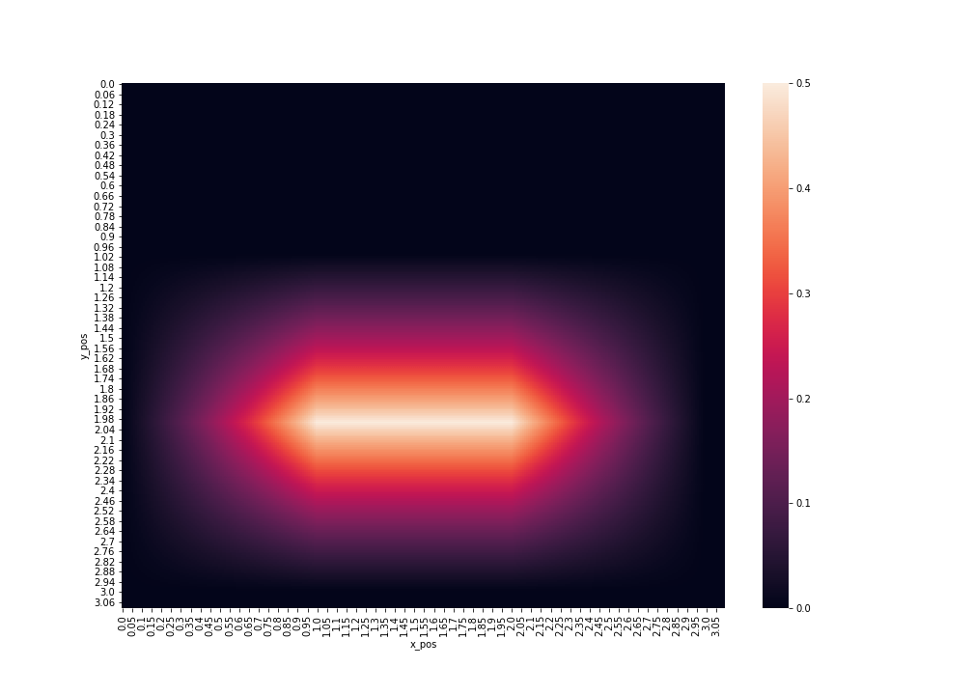
IoU - Intersection over Union
Predicted bounding box is twice as big as the groundtruth.

Slide 7
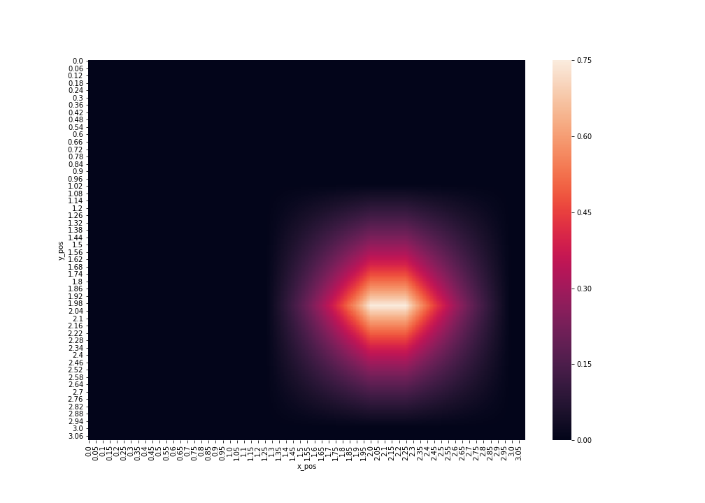
IoU - Intersection over Union
Predicted bounding box is 25% smaller than the groundtruth.

Slide 8
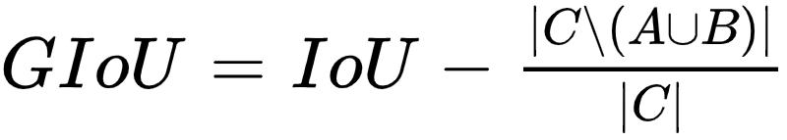
Generalized IoU
IoU has a plateau making it infeasible to optimize in the case of non-overlapping bounding boxes
GIoU to solve this problem.
Where C is the smallest enclosing convex object for A and B.
Notes:
By incorporating this generalized IoU (GIoU) as a loss into the state-of-the art object detection frameworks, we show a consistent improvement on their performance using both the standard, IoU based, and new, GIoU based, performance measures on popular object detection benchmarks such as PASCAL VOC and MS COCO

Slide 9
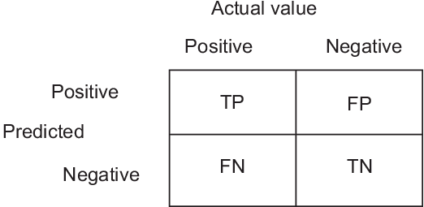
Prediction outcomes

Slide 10
Prediction outcomes
True Positive: IoU > 0.5
False Positive:
IoU <= 0.5
Duplicated Bounding Boxes
No IoU
False Negative: Iou > 0.5 but the bounding box has the wrong classification
True Negative: Usually there are not true negatives as the images are expected to contain at least one object
Notes:
fewer false positives (we make fewer mistakes)
more false negatives (we miss more objects)

Slide 11
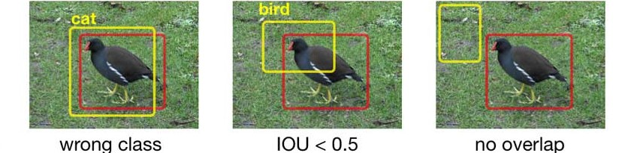
False Positive examples

Slide 12
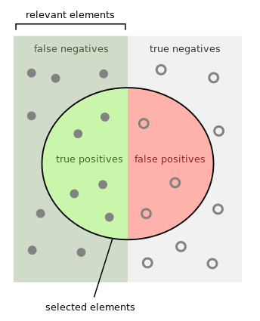
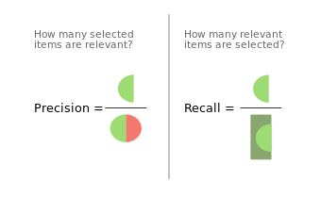
Precision and Recall
Notes:
Precision measures how accurate is your predictions. i.e. the percentage of your predictions are correct.
Recall measures how good you find all the positives. For example, we can find 80% of the possible positive cases in our top K predictions.

Slide 13
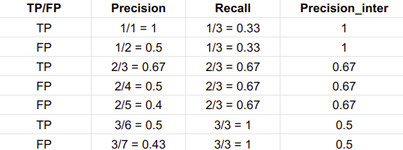
Precision and Recall

Slide 14
Precision and Recall

Slide 15
Precision and Recall

Slide 16
Precision and Recall

Slide 17
Precision and Recall

Slide 18
Precision and Recall

Slide 19
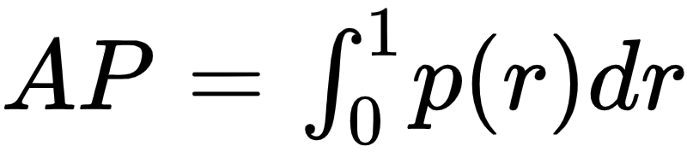
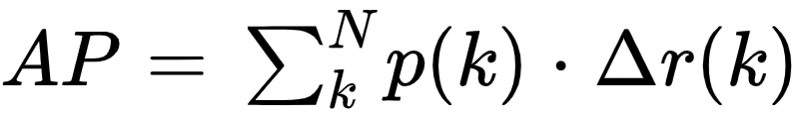
AP - Average Precision
Precision averaged across all values of recall between 0 and 1
Equal to taking the area under the precision/recall curve
This integral can be approximated by a sum over the precisions at every possible threshold value, multiplied by the change in recall, N is the total number of images in the collection, p(k) is the precision at a cutoff of k images, and delta r(k) is the change in recall that happened between cutoff k-1 and cutoff k.
Notes:
The general definition for the Average Precision (AP) is finding the area under the precision-recall curve above.
Precision and recall are always between 0 and 1. Therefore, AP falls within 0 and 1 also. Before calculating AP for the object detection, we often smooth out the zigzag pattern first.

Slide 20
Approximated Average Precision
(1 * 0.33) + (0.5 * 0) + (0.67 * 0.33) + (0.5 * 0) + (0.4 * 0) + (0.5 * 0.33) + (0.43 * 0) = 0.7161

Slide 21
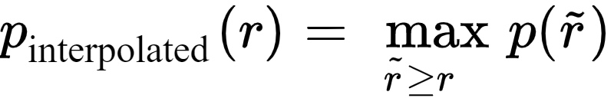
Interpolated AP
Interpolated AP: replace each precision value with the maximum precision value to the right of that recall level to reduce the impact of the “wiggles” in the precision/recall curve.

Slide 22
Interpolated AP
Interpolated AP: replace each precision value with the maximum precision value to the right of that recall level to reduce the impact of the “wiggles” in the precision/recall curve.

Slide 23
Interpolated AP
Interpolated AP: replace each precision value with the maximum precision value to the right of that recall level to reduce the impact of the “wiggles” in the precision/recall curve.

Slide 24
Interpolated AP
Interpolated AP: replace each precision value with the maximum precision value to the right of that recall level to reduce the impact of the “wiggles” in the precision/recall curve.

Slide 25
Interpolated AP
Interpolated AP: replace each precision value with the maximum precision value to the right of that recall level to reduce the impact of the “wiggles” in the precision/recall curve.

Slide 26
Interpolated AP
Interpolated AP: replace each precision value with the maximum precision value to the right of that recall level to reduce the impact of the “wiggles” in the precision/recall curve.

Slide 27
Interpolated AP
Interpolated AP: replace each precision value with the maximum precision value to the right of that recall level to reduce the impact of the “wiggles” in the precision/recall curve.

Slide 28
Interpolated AP
Interpolated AP: replace each precision value with the maximum precision value to the right of that recall level to reduce the impact of the “wiggles” in the precision/recall curve.
Notes:
The intention in interpolating the precision/recall curve in this way is to reduce the impact of the “wiggles” in the precision/recall curve, caused by small variations in the ranking of examples.

Slide 29
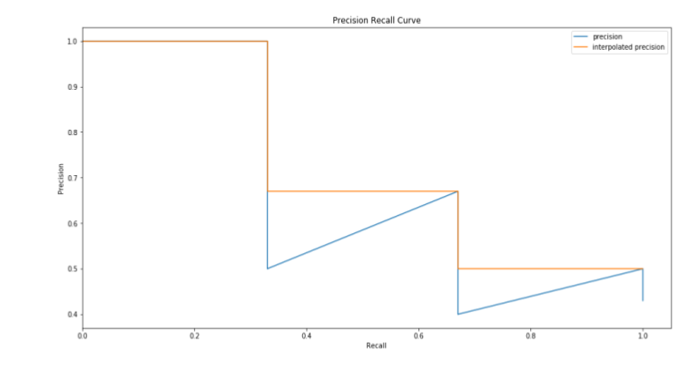

Interpolated AP, Pascal VOC2008
AP = 1/11 * (1 + 1 + 1 + 1 + 0.67 + 0.67 + 0.67 + 0.5 + 0.5 + 0.5 + 0.5) = 0.7282
Notes:
In Pascal VOC2008, an average for the 11-point interpolated AP is calculated.
However, this interpolated method is an approximation which suffers two issues. It is less precise. Second, it lost the capability in measuring the difference for methods with low AP. Therefore, a different AP calculation is adopted after 2008 for PASCAL VOC
Precision/Recall curves are for different classes, e.g. the class “dog” -> how well does the model classify and locate dogs

Slide 30
Interpolated AP, Pascal VOC2010-2012
Area under curve (AUC)
Samples the curve at all unique recall values (r₁, r₂, …), whenever the maximum precision value drops. With this change, we are measuring the exact area under the precision-recall curve after the zigzags are removed.
(0.33* 1) + (0.33 * 0.67) + (0.33 * 0.5) + = 0.7161
Notes:
This will turn out with the same value as our approximate example

Slide 31
Approximated vs. Interpolated AP
In our little example they are the same, but these next two graphs will highlight the fact that this isn’t always the case

Slide 32
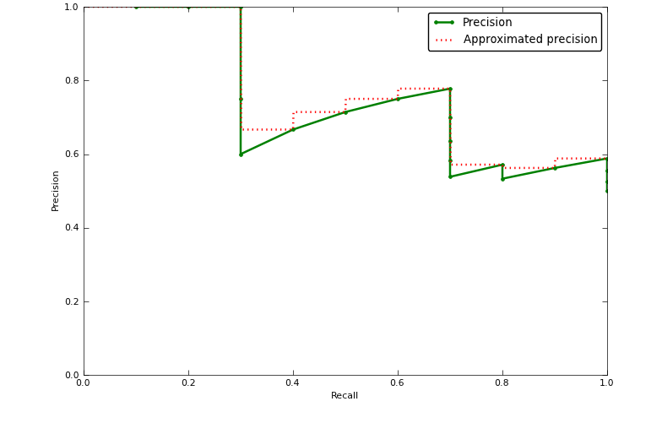
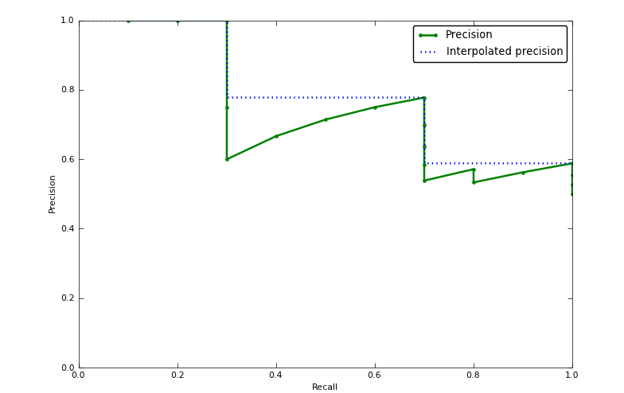
Approximated vs. Interpolated AP

Slide 33
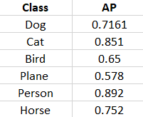
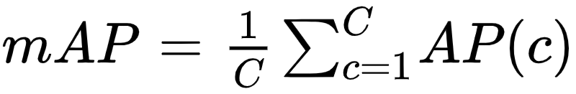
AP and mAP
AP is the average precision score for one class, e.g. “dog” while mAp (mean average precision) is simply the average over the average precisions for all the classes our model should be able to detect
1/6 * (0.7161 + 0.851 + 0.65 + 0.578 + 0.892 + 0.752) = 0.73985

Slide 34
Resources
https://sanchom.wordpress.com/tag/average-precision/
https://machinethink.net/blog/object-detection/
http://host.robots.ox.ac.uk/pascal/VOC/pubs/everingham10.pdf
https://towardsdatascience.com/breaking-down-mean-average-precision-map-ae462f623a52
https://medium.com/@jonathan_hui/map-mean-average-precision-for-object-detection-45c121a31173
https://arxiv.org/pdf/1902.09630.pdf

